Slide 1
AltUni Regression with a Media Campaign Cost – Project Report
Dataset Description
The dataset for this competition (both train and test) was generated from a deep learning model trained on the Media Campaign Cost Prediction dataset. Feature distributions are close to, but not the same, as the original. Feel free to use the original dataset as part of this competition, both to explore differences as well as to see whether incorporating the original in training improves model performance.
Files
train.csv - the training dataset; cost is the target
test.csv - the test dataset; your objective is to predict cost
sample_submission.csv - a sample submission file in the correct format
Problem Statement
Root Mean Squared Log Error (RMLSE)
Submissions are scored on the root mean squared log error (RMSLE) (the sklearn mean_squared_log_error with squared=False).
Submission File
For each id in the test set, you must predict the value for the target cost.

Slide 2
Step – 1: Importing Libraries
library(dplyr)
library(ggplot2)
library(DataExplorer)
library(summarytools)
library(reshape2)
library(corrplot)
Step – 2: Importing Data
train_data <- read.csv("D:/ALTUNI/PROJECTS/R/Media Campaign/train.csv")
test_data <- read.csv("D:/ALTUNI/PROJECTS/R/Media Campaign/test.csv")

Slide 3
Step – 3: Data Summary
Summary of train_data
 | id | store_sales.in.millions. | unit_sales.in.millions. | total_children | num_children_at_home | avg_cars_at.home.approx..1 | gross_weight | recyclable_package | low_fat | units_per_case | store_sqft | coffee_bar | video_store | salad_bar | prepared_food | florist | cost
Min. | 0 | 0.510 | 1.000 | 0.000 | 0.0000 | 0.000 | 6.000 | 0.000 | 0.0000 | 1.000 | 20319 | 0.0000 | 0.0000 | 0.0000 | 0.0000 | 0.0000 | 50.79
1st Qu. | 90084 | 3.720 | 3.000 | 1.000 | 0.0000 | 1.000 | 9.710 | 0.000 | 0.0000 | 10.000 | 23593 | 0.0000 | 0.0000 | 0.0000 | 0.0000 | 0.0000 | 70.32
Median | 180168 | 5.780 | 3.000 | 2.000 | 0.0000 | 2.000 | 13.600 | 1.000 | 0.0000 | 20.000 | 27694 | 1.0000 | 0.0000 | 1.0000 | 1.0000 | 1.0000 | 98.81
Mean | 180168 | 6.337 | 3.044 | 2.456 | 0.6894 | 2.204 | 13.820 | 0.568 | 0.3278 | 18.970 | 28180 | 0.5648 | 0.2774 | 0.5048 | 0.5048 | 0.5032 | 99.61
3rd Qu. | 270251 | 8.400 | 4.000 | 4.000 | 1.0000 | 3.000 | 17.700 | 1.000 | 1.0000 | 28.000 | 33858 | 1.0000 | 1.0000 | 1.0000 | 1.0000 | 1.0000 | 126.62
Max. | 360335 | 22.920 | 6.000 | 5.000 | 5.0000 | 4.000 | 21.900 | 1.000 | 1.0000 | 36.000 | 39696 | 1.0000 | 1.0000 | 1.0000 | 1.0000 | 1.0000 | 149.75
Summary of test_data
 | id | store_sales.in.millions. | unit_sales.in.millions. | total_children | num_children_at_home | avg_cars_at.home.approx..1 | gross_weight | recyclable_package | low_fat | units_per_case | store_sqft | coffee_bar | video_store | salad_bar | prepared_food | florist
Min. | 360336 | 0.510 | 1.000 | 0.000 | 0.0000 | 0.000 | 6.000 | 0.0000 | 0.0000 | 1.000 | 20319 | 0.0000 | 0.0000 | 0.0000 | 0.0000 | 0.0000
1st Qu. | 420392 | 3.750 | 3.000 | 1.000 | 0.0000 | 1.000 | 9.710 | 0.0000 | 0.0000 | 10.000 | 23593 | 0.0000 | 0.0000 | 0.0000 | 0.0000 | 0.0000
Median | 480448 | 5.800 | 3.000 | 2.000 | 0.0000 | 2.000 | 13.600 | 1.0000 | 0.0000 | 20.000 | 27694 | 1.0000 | 0.0000 | 1.0000 | 1.0000 | 1.0000
Mean | 480448 | 6.354 | 3.044 | 2.454 | 0.6854 | 2.198 | 13.830 | 0.5657 | 0.3269 | 18.960 | 28175 | 0.5642 | 0.2756 | 0.5044 | 0.5044 | 0.5018
3rd Qu. | 540503 | 8.400 | 4.000 | 4.000 | 1.0000 | 3.000 | 17.800 | 1.0000 | 1.0000 | 28.000 | 33858 | 1.0000 | 1.0000 | 1.0000 | 1.0000 | 1.0000
Max. | 600559 | 22.920 | 6.000 | 5.000 | 5.0000 | 4.000 | 21.900 | 1.0000 | 1.0000 | 36.000 | 39696 | 1.0000 | 1.0000 | 1.0000 | 1.0000 | 1.0000

Slide 4
Step – 4: Data Cleaning
There are no missing values in the train_data.
There are no outliers in the train_data.
There are no duplicated rows in the train_data.

Slide 5
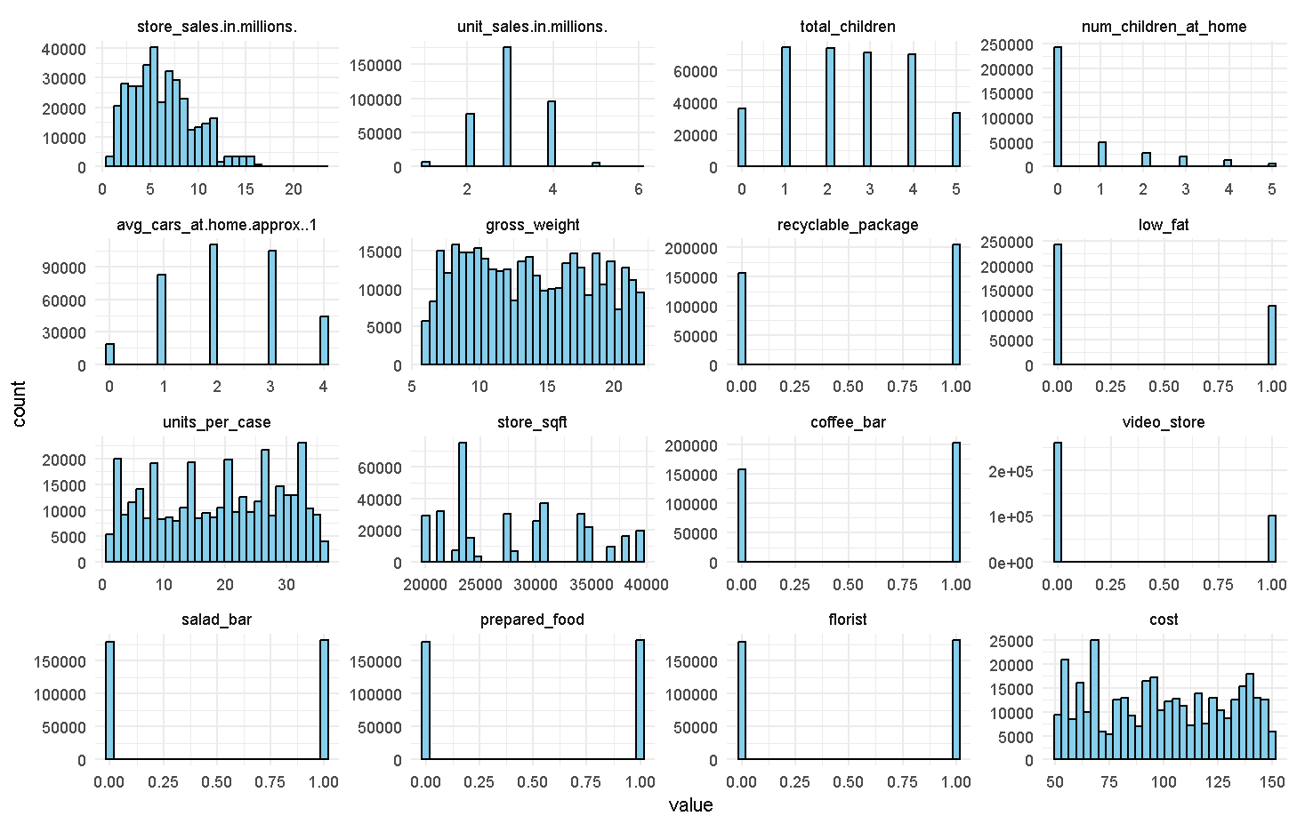
Histogram plots for all the columns except id column for train_data is as follows:
From these histograms, all the following columns are the categorical variables.
unit_sales.in.millions., total_children, num_children_at_home, avg_cars_at.home.approx..1, recyclable_package, low_fat, coffee_bar, video_store, salad_bar, prepared_food, florist
store_sales.in.millions. is positively skewed.
gross_weight, unit_per_case, cost are multi – modal distributions.

Slide 6
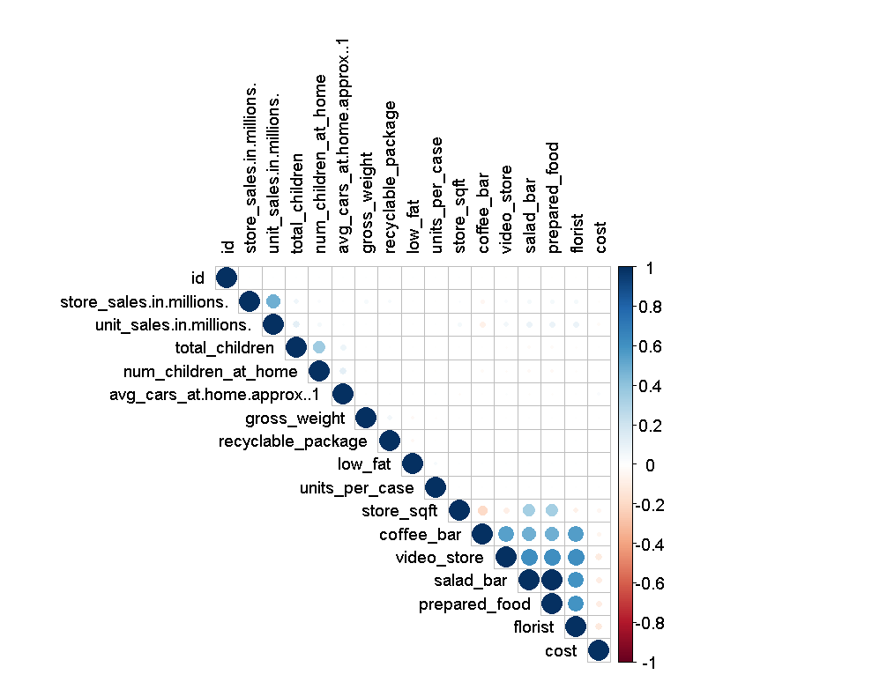
Correlation Matrix
There is a strong positive correlation between store_sales.in.millions. & unit_sales.in.millions.
There is a moderate correlation between total_children & num_children_at_home.
There is a strong negative correlation between prepared_food & florist.

Slide 7
Step – 5: Model Building
Splitted the train data into train set and validation set according to 80-20 rule.
Built two models to predict media cost in train data i.e., (1) Linear Regression Model & (2) XG Boost Model and computed RMSLE from each model.
RMSLE on Validation Set (Linear Regression): 0.3160414
RMSLE on Validation Set (XGBoost): 0.2971233
Since RMSLE is lower for XG Boost model than that of Linear Regression Model, hence calculated the new predictions for cost variable on test data using XG Boost Model.
id | Cost
360336 | 100.92557
360337 | 102.23499
360338 | 94.98256
360339 | 100.55412
360340 | 81.45965

